Slide 1
Assistance Please! My Child is Off Task: Promoting Self-Discipline Strategies at Home
Sand Hills GNETS Corner

Slide 2
GNETS Mission Statement
Teach students the values and skills they need to live a successful life filled with a sense of belonging, a love for learning, and compassion for others.

Slide 3
GNETS Vision Statement
Our Vision is to see students learn or rediscover skills that will help them to benefit from academic instruction in the least restrictive school environment available to them. Learning to use words to communicate ideas and feelings and discovering the value of being a group member enhances a student's ability to achieve. By working cooperatively with our students, their parents, local school personnel, and other community agencies our students will become lifelong learners and productive citizens.

Slide 4
Topics of Discussion
Define behavior expectations based on your core values.
Define specific behavior you want to see, aligned to your core values.
Identify how to shape and manage your child’s behavior.
Reasons why misbehavior happens.
Key strategies to remember.
Praise good behavior and celebrate their success.
Building a home plan

Slide 5
Behavior Expectations (Based on Core Values)
Treat others with respect and courtesy
Hands off- be sure your behavior does not result in touching another individual
Be prepared for learning- have all your required materials in your learning space
Respect the home learning environment
Off task behavior can result in a consequence

Slide 6
What Behaviors Should be Displayed? (A lot of Modeling & Re-Teaching)
Consideration of others learning space
Consideration of computer device usage (sharing of computers with siblings etc.)
Use of indoor voice (no yelling or screaming)
Hands off behavior
Listen to parent when speaking no interruptions
Display empathy and kindness

Slide 7
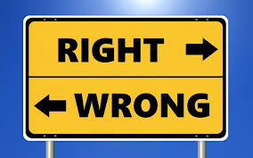
Identify How to Shape & Manage Your Child’s Behavior
Model the behavior you expect
Point out sharing among adults
Teach children to say how they feel
The Attention Meter: Interact with your child, it goes a long way

Slide 8
Three Reasons Why Misbehavior Happens
They don’t understand the expectation
May not have the skills to meet the expectation
It gets them what they want

Slide 9
Key Strategies to Remember
Be explicit with your expectations
Always controlled choice
Remember everything we do is a choice except breathing and blinking
Avoid power struggles
Give your child time to make their choice

Slide 10
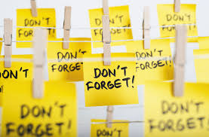
Key Strategies to Remember
Address miscues in behavior quickly and move on quickly
Take time to celebrate when your child adheres behavior expectations and or corrects misbehavior

Slide 11
Praise Good Behavior & Celebrate Their Success
Provide positive attention and praise whenever your child demonstrates self-discipline.
Be intentional on pointing out the good behavior you want to see more often.
Provide praise when children do things without requiring reminders.
Suggestion: Have a family “goal” or an individual goal for your child. They can earn a reward that may encompass a family “water” day or something that the child is interested in.

Slide 12
Building A Home Plan
Dedicated a workspace
Space for supplies
Post child’s schedule
Specific times set aside for school, play and downtime
Write in Agenda/or Specialized Binder daily or weekly
Ask child’s teacher for a weekly calendar of assignments and live lessons

Slide 13
Reflection
“What you do today can improve all of your tomorrows.”
-Ralph Marston

Slide 14
Quenshauna Motley Smith, Ed.D.
Sand Hills GNETS Liaison
Sand Hills GNETS
motlequ1@boe.Richmond.k12.ga.us

